Slide 1
Progress Report
Used Cars Data
Kelompok 10 :
1. Kintan Pitaloka W
2. Rizky Muhammad Kahfie
3. Abdillah Fikri
3 Oktober 2020

Slide 2
Understanding the data
Name
Location
Year
Kilometers
Driven
Fuel Type
Transmission
Owner Type
Mileage
Engine
Power
Seats
Price
12 columns and 6019 rows available with several findings :
1. Various Type (Int, Object, Float )
2. Missing and Invalid Values detected

Slide 3
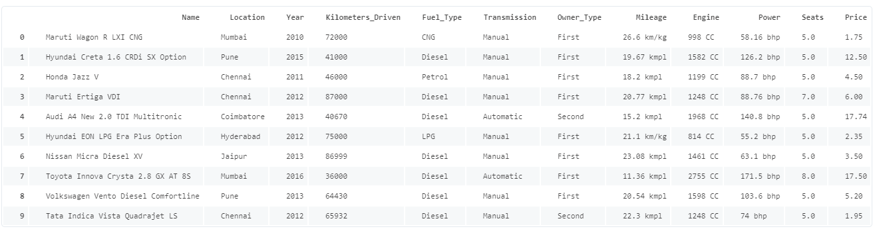
Understanding the data
Next Plan :
Objektif dari pemodelan ini adalah memprediksi value Price dengan metode Regressi
Rencana model yang akan dipakai adalah Linear Regression dan Random Forest Regression

Slide 4
Review By Columns
Several findings :
1. Type Data (Object)
2. Diproses dengan Apply lambda
Index 1 = Car Maker
Index 2 = Car Type
3. Setelah dipecah terdapat duplicate value berupa ‘ISUZU’ yang harusnya tertulis ‘Isuzu’
Several findings :
1. Type Data (Object)
2. Rentang tahun 1998 - 2019
Name
Year
Several findings :
1. Type Data (Object)
2. Nama nama Location rata-rata merupakan Kota Metropolitan yang ada di India
Several findings :
1. Type Data (Int64)
Kilometers
Driven
Location

Slide 5
Review By Columns
Several findings :
1. Type Data (Object)
2. Terdapat 5 jenis Fuel :
CNG, Diesel, Petrol, LPG , Electric
Several findings :
1. Type Data (Object)
2.Terdapat 4 Jenis Owner type :
First, Second, Third , Fourth & Above
Fuel Type
Owner Type
Several findings :
1. Type Data (Object)
2. Terdapat 2 Jenis Transmission :
Manual & Automatic
Several findings :
1. Type Data (Object)
2. Beda satuan kmpl & km/kg
3. Terdapat Missing value.
Jumlah ada 70, 2 berupa NaN &
68 sisanya berupa 0.0
Mileage
Transmission

Slide 6
Review By Columns
Several findings :
1. Type Data (Float64)
2. Terdapat 43 missing value, yang mana 42 nya berupa NaN dan 1 berupa 0
Several findings :
1. Type Data (Object)
2. Terdapat Missing Value sebanyak 36 berupa NaN
Engine
Seats
Several findings :
1. Type Data (Float64)
2. Menggunakan satuan Lakhs (India)
3. Jika dilihat melalui Distribution Plot
pada bagian ini mempunyai Right Skew
Several findings :
1. Type Data (Object)
2. Terdapat missing values sebanyak
36 berupa NaN dan 107 berupa null bhp
Power
Price

